Slide 1

COMPUTER VISION
An Introduction to Image Processing Concepts
Course Code: DS4150

Slide 2
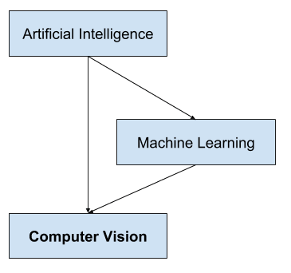
Introduction to Computer Vision
What is Computer Vision? Computer vision is a field of study that enables machines to interpret and understand visual information from the world, such as images and videos.

Slide 3
Objective of Computer Vision
To automate tasks that the human visual system can do — e.g., object detection, recognition, tracking, and scene understanding.
Key Applications:
Medical Imaging: Tumor detection, X-ray analysis
Surveillance: Intruder detection, face recognition
Autonomous Vehicles: Road/lane detection, pedestrian recognition
Robotics & Automation: Navigation, object manipulation
Retail: Customer behavior analysis, inventory monitoring

Slide 4
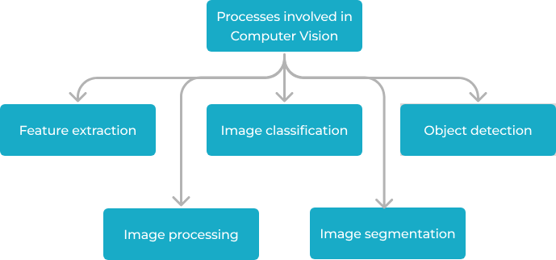

Slide 5
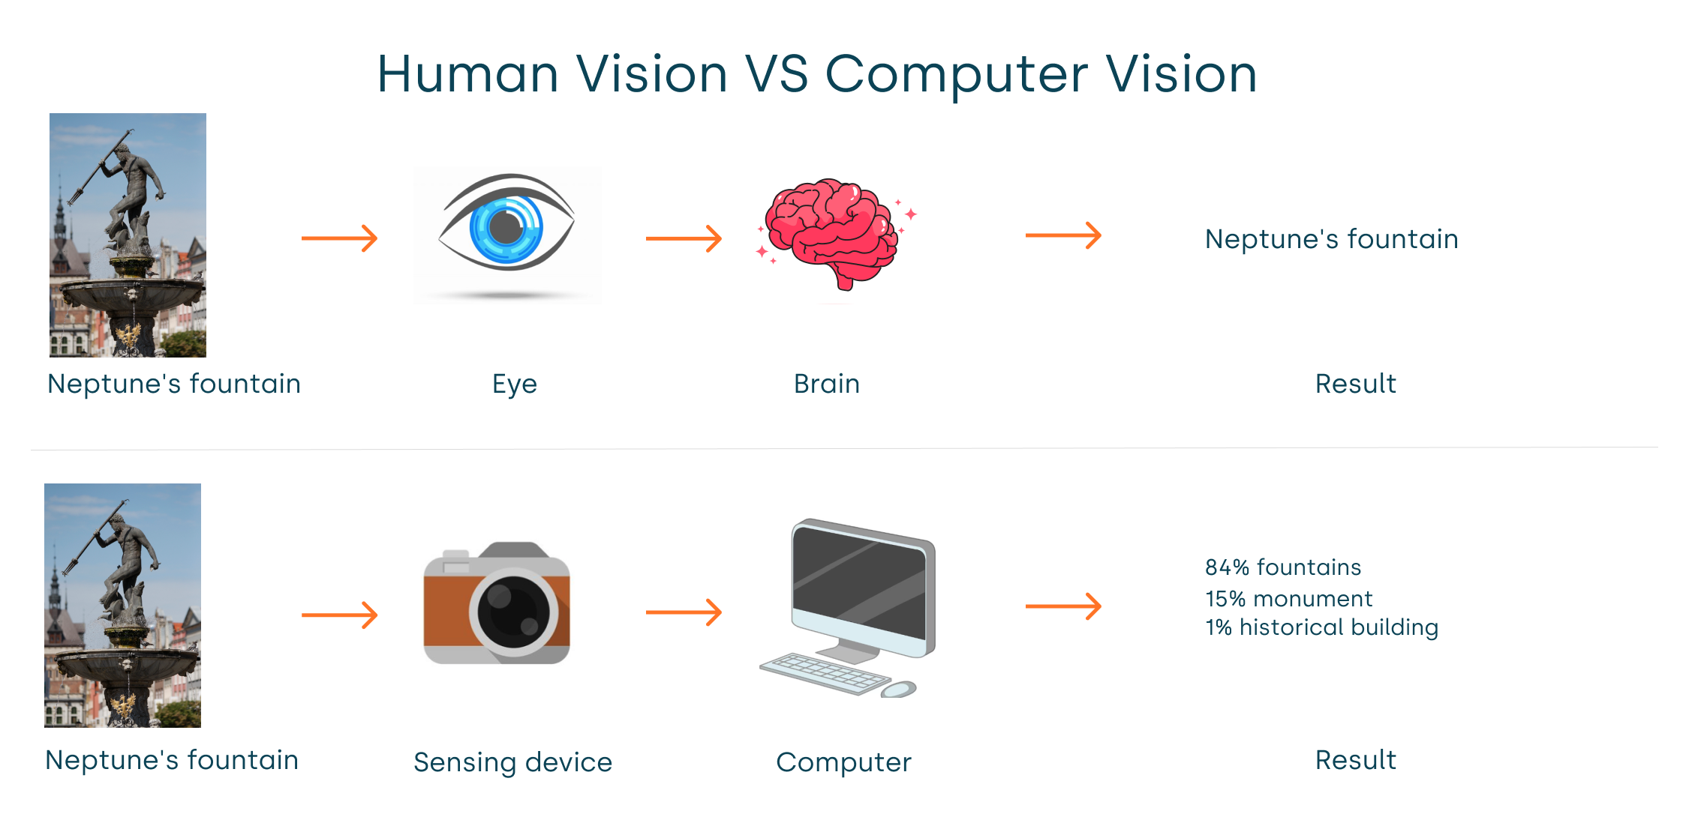

Slide 6
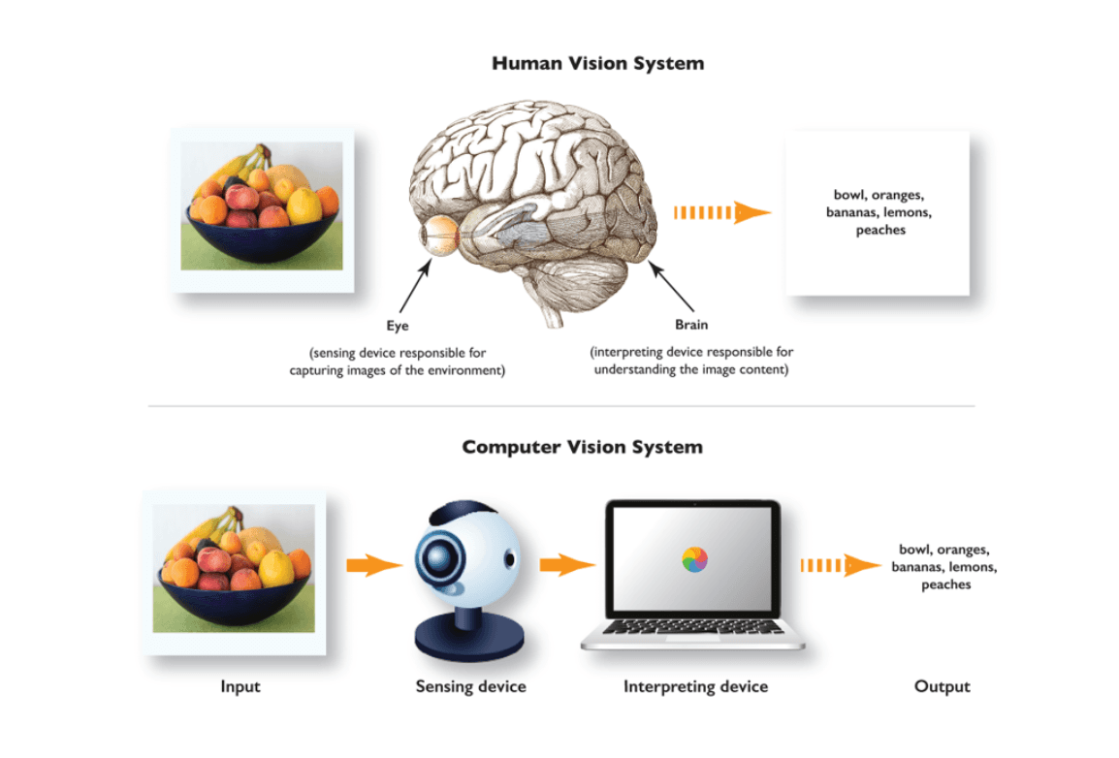

Slide 7
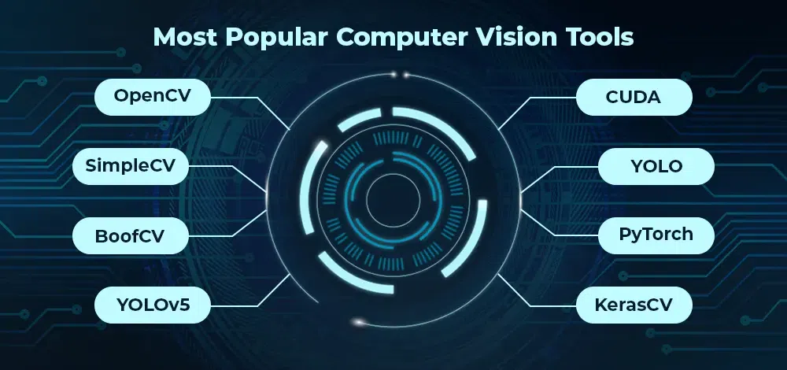

Slide 8

Relation with Image Processing
Image processing focuses on improving the visual quality of an image (e.g., filtering, enhancement), whereas computer vision goes further by attempting to extract meaningful understanding from the image.

Slide 9
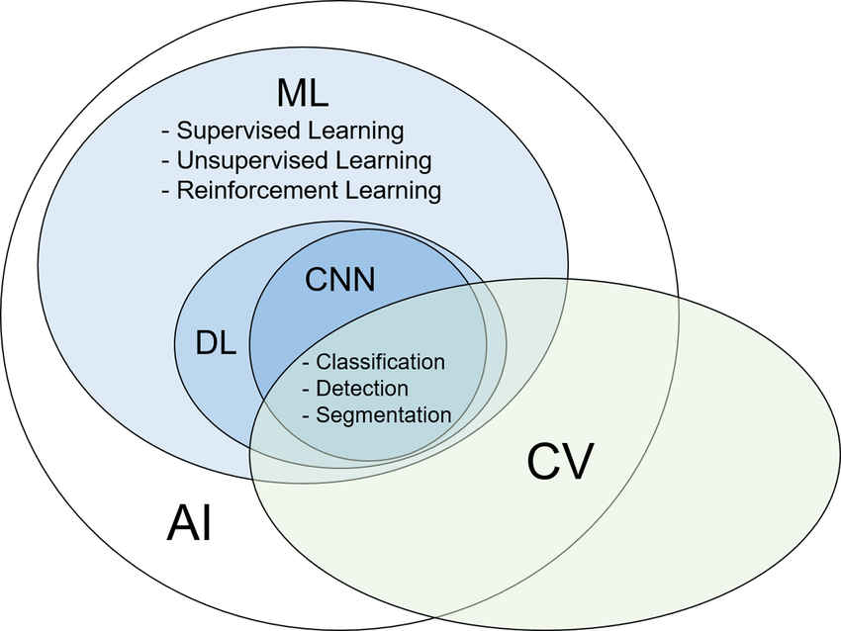
Relationships between the terminologies

Slide 10
Image Processing – An Overview
What is Image Processing? A method to perform operations on an image to enhance it or extract useful information.
Two Main Types:
Analog Image Processing (used in photography, print media)
Digital Image Processing (performed on digital images using computers)
Goals of Image Processing:
Improve visual appearance for human interpretation
Prepare images for automatic analysis (computer vision, machine learning)

Slide 11
Common Applications
Noise removal
Contrast enhancement
Edge detection
Image compression
Object segmentation

Slide 12
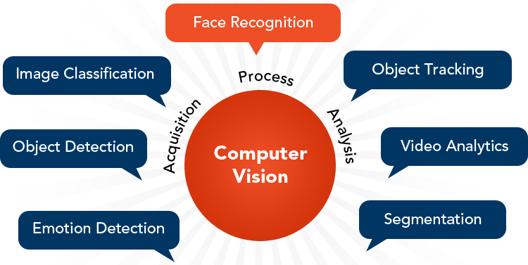

Slide 13
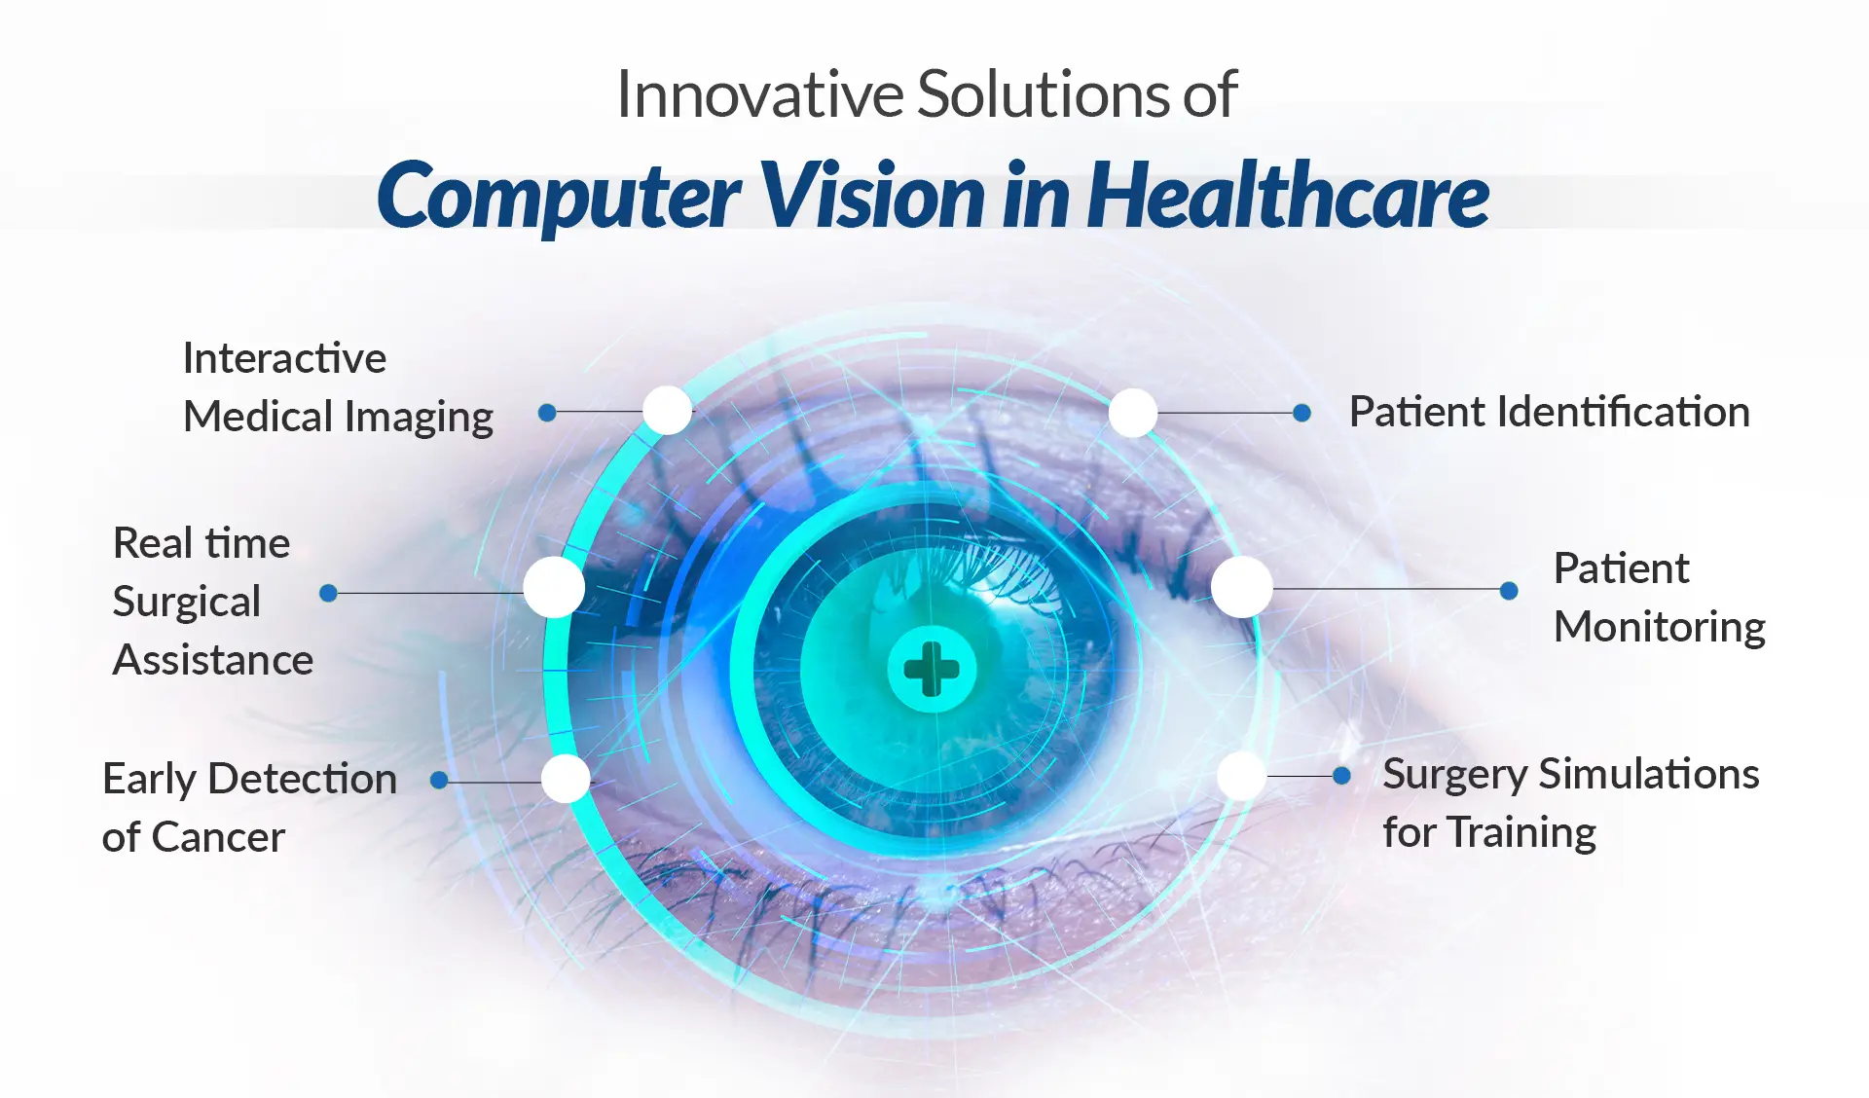

Slide 14
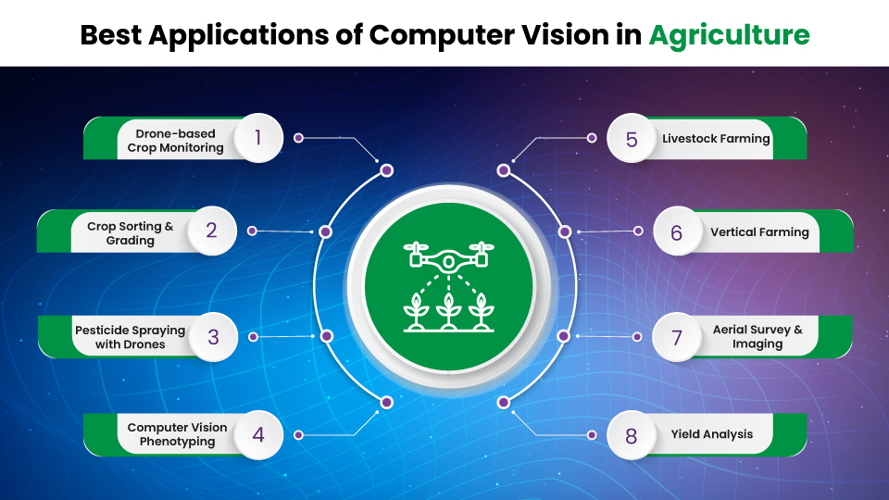

Slide 15
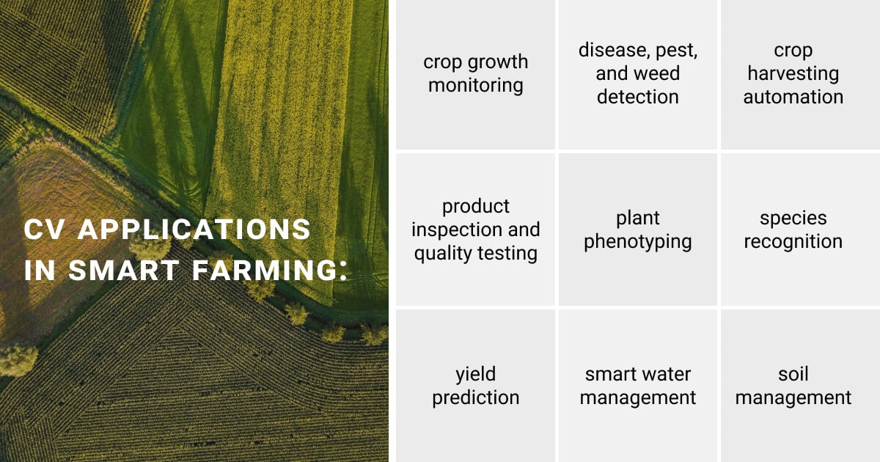

Slide 16
